Slide 1
Data Warehousing & Data Mining

Slide 2
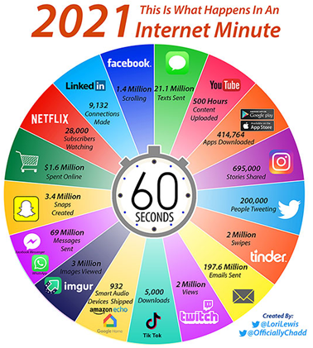

Slide 3
Need for Data Mining
Data perspective
Explosive growth
Abundant sources
Lack of knowledge
Availability of computing power

Slide 4
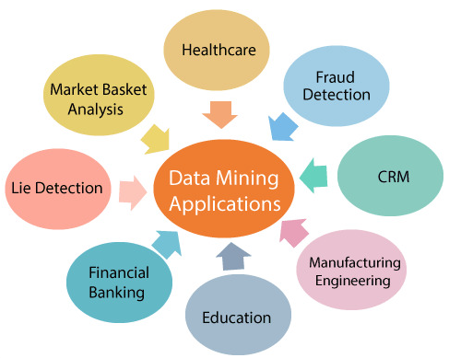
Application perspective

Slide 5
Overview of Syllabus

Slide 6
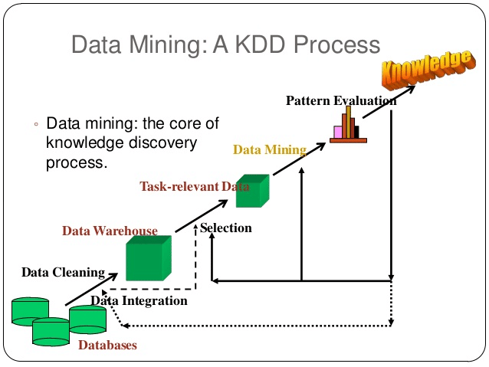
1. Introduction to Data Mining
Basic concepts of data mining,
Types of Data to be mined
Stages of the Data Mining Process
Data Mining Techniques
Knowledge Discovery in Databases
Data Mining Issues
Applications of Data mining

Slide 7
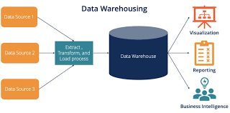
2. Introduction to Data Warehouse
Data Warehouse and DBMS Architecture of Data Warehouse, Multidimensional data model
Concepts of OLAP and Data Cube
OLAP operations
Dimensional Data Modelling- Star, Snow flake schemas

Slide 8
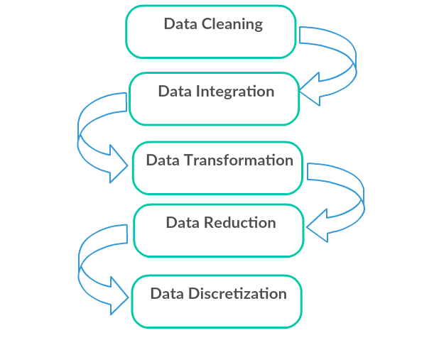
3. Data pre-processing
Need Data pre-processing
Attributes and Data types
Statistical descriptions of Data
Handling missing Data
Data sampling
Data cleaning
Data Integration and transformation
Data reduction
Discretization and generating concept hierarchies

Slide 9
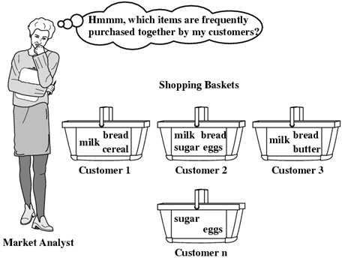
4. Data Mining Techniques
Association Rule Mining: Basic idea: item sets, Frequent Item-sets, Association Rule Mining, Generating item sets and rules efficiently

Slide 10
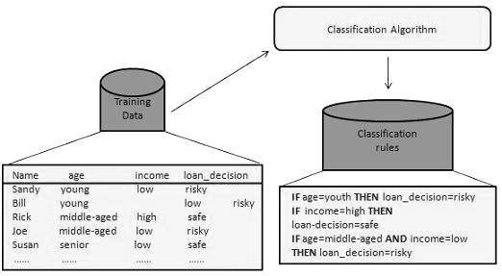
5. Data Mining Techniques
Classification: Definition of Classification, Decision tree Induction: Information gain, Issues: Over-fitting, tree pruning methods,
Bayesian Classification: Bayes Theorem, Naïve Bayes classifier, Bayesian Networks

Slide 11
6. Introduction to Weka Tool
Introduction
Installation
Loading data
File formats
Preprocessing the data
Run learned classifiers

